Slide 1
Module-3 CONTROL UNIT OPERATION

Slide 2
Micro operations-CU
The execution of an instruction involves the execution of a sequence of substeps, generally called cycles.
For example, an execution may consist of fetch, indirect, execute, and interrupt cycles. Each cycle is in turn made up of a sequence of more fundamental operations, called micro-operations.

Slide 3
Micro operations-CU
A single micro-operation generally involves a transfer between registers, a transfer between a register and an external bus, or a simple ALU operation.

Slide 4
CONTROL UNIT
The control unit of a processor performs two tasks:
(1) It causes the processor to step through a series of micro-operations in the proper sequence, based on the program being executed.
(2) it generates the control signals that cause each micro-operation to be executed.

Slide 5
MICRO-OPERATIONS
Execution of a program -sequential execution of instructions.
Each instruction executed during an instruction cycle made up of shorter sub cycles (e.g., fetch, indirect, execute, interrupt).
Execution of each sub cycle involves one or more shorter operations,- micro-operations

Slide 6
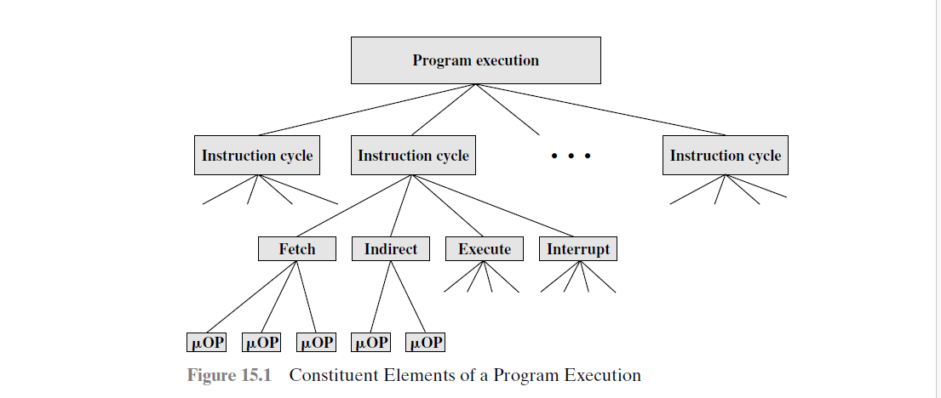
MICRO-OPERATIONS
Functional-atomic operations of a processor.

Slide 7
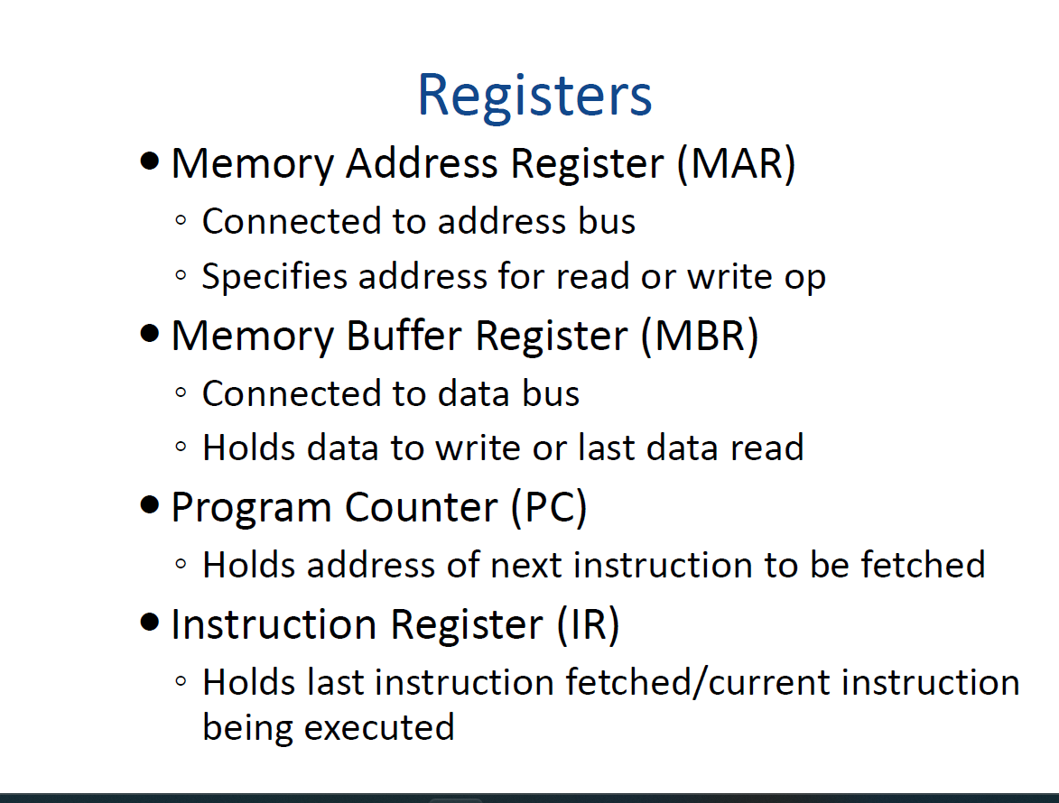

Slide 8
FETCH CYCLE
Four registers are involved:-
Memory address register (MAR): Is connected to the address lines of the system bus. It specifies the address in memory for a read or write operation.
Memory buffer register (MBR): Is connected to the data lines of the system bus. Contains the value to be stored in memory or the last value read from memory.
Program counter (PC): Holds the address of the next instruction to be fetched.
Instruction register (IR): Holds the last instruction fetched.

Slide 9
Eg:-FETCH OPERATION
Beginning of the fetch cycle- address of the next instruction to be executed in the program counter (PC); Let, the address is 1100100.
1.Move that address to the memory address register (MAR)
2.Bring in the instruction. The desired address (in the MAR) is placed on the address bus.

Slide 10
Eg:-FETCH OPERATION
3.The control unit issues a READ command on the control bus, and the result appears on the data bus and is copied into the memory buffer register (MBR).
4.Also increment the PC

Slide 11
FETCH
The simple fetch cycle consists of three steps and four micro operations.
Each micro-operation involves the movement of data into or out of a register.
If these movements do not interfere , several of them can take place during one step, saving time.

Slide 12
FETCH
.
t1:MAR (PC)
t2: MBR Memory
t3: PC ← (PC) + I
IR ← (MBR)

Slide 13
INDIRECT CYCLE
The address field of the instruction is transferred to the MAR.
This is then used to fetch the address of the operand.
address field of the IR is updated from the MBR, so that it now contains a direct rather than an indirect address.
The IR is now in the same state as if indirect addressing had not been used, and it is ready for the execute CYCLE.

Slide 14
INDIRECT CYCLE
.
t1:MAR ←(IR(Address))
.
t2:MBR ←Memory
.
t3:IR(Address)←(MBR(Address))

Slide 15
The Interrupt Cycle
At the completion of the execute cycle, a test is made to determine whether any enabled interrupts have occurred.
If so, the interrupt cycle occurs.
.
t1:MBR←(PC)
.
t2:MAR←Save_Address
.
PC← Routine_Address
.
t3:Memory←(MBR)

Slide 16
INTERUPT CYCLE
In the first step, the contents of the PC are transferred to the MBR, so that they can be saved for return from the interrupt.
Then the MAR is loaded with the address
at which the contents of the PC are to be saved, and the PC is loaded with the address
of the start of the interrupt-processing routine.

Slide 17
INTERUPT CYCLE
the final step is to store the MBR, which contains the old value of the PC, into memory.
The processor is now ready to begin the next instruction cycle.

Slide 18
EXECUTE CYCLE
The fetch, indirect, and interrupt cycles are simple and predictable.
This is not true of the execute cycle. Because of the variety opcodes, there are a number of different sequences of micro-operations that can occur.

Slide 19
EXECUTE CYCLE
EG:-ADD R1, X
which adds the contents of the location X to register R1. The following sequence of
micro-operations might occur:
.
t1:MAR←(IR(address))
.
t2:MBR←Memory
.
t3:R1←(R1) + (MBR)

Slide 20
EXECUTE CYCLE
We begin with the IR containing the ADD instruction.
In the first step, the ad dress portion of the IR is loaded into the MAR.
Then the referenced memory loca tion
is read. Finally, the contents of R1 and MBR are added by the ALU.

Slide 21
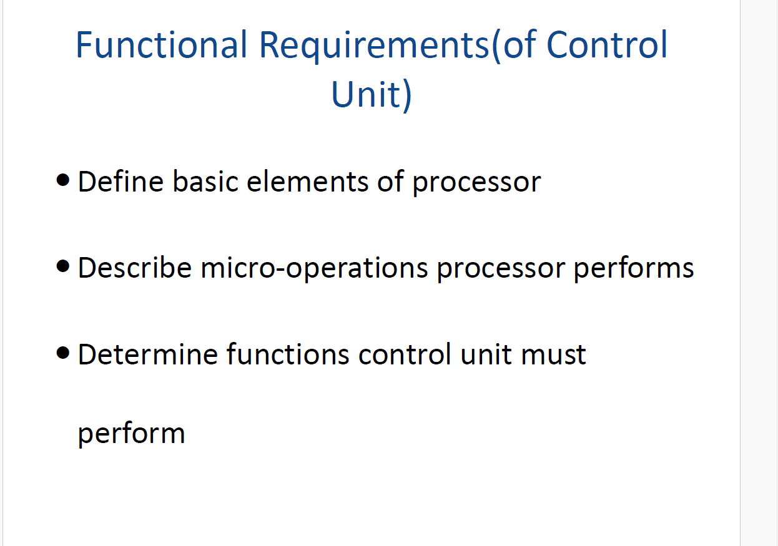

Slide 22
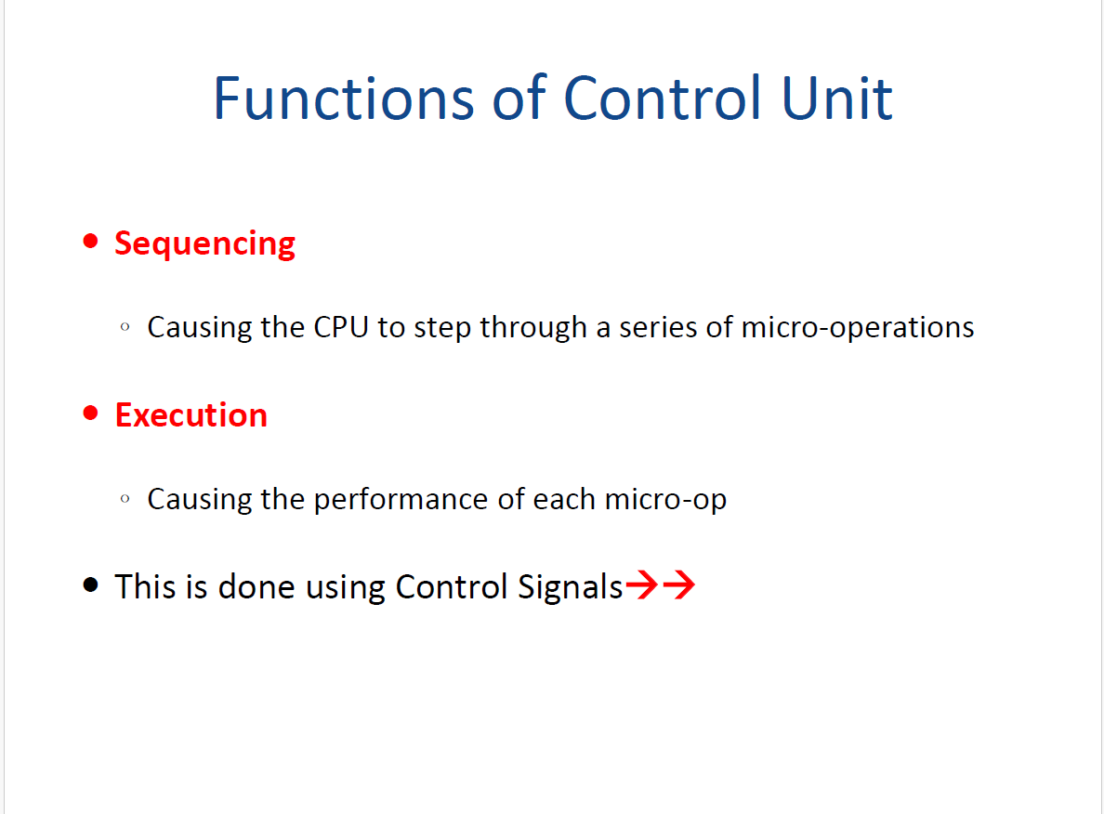

Slide 23
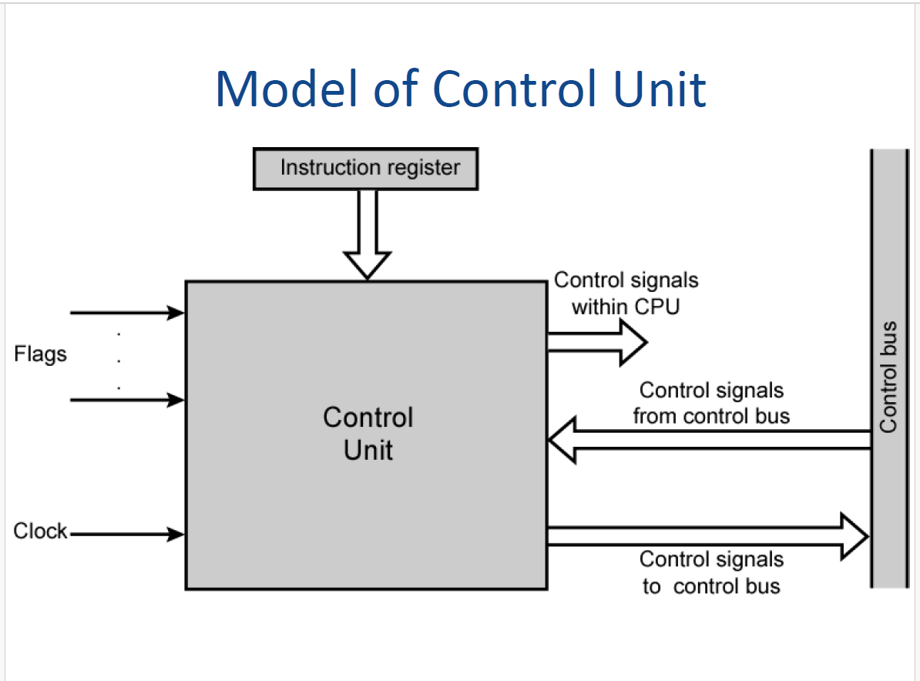

Slide 24
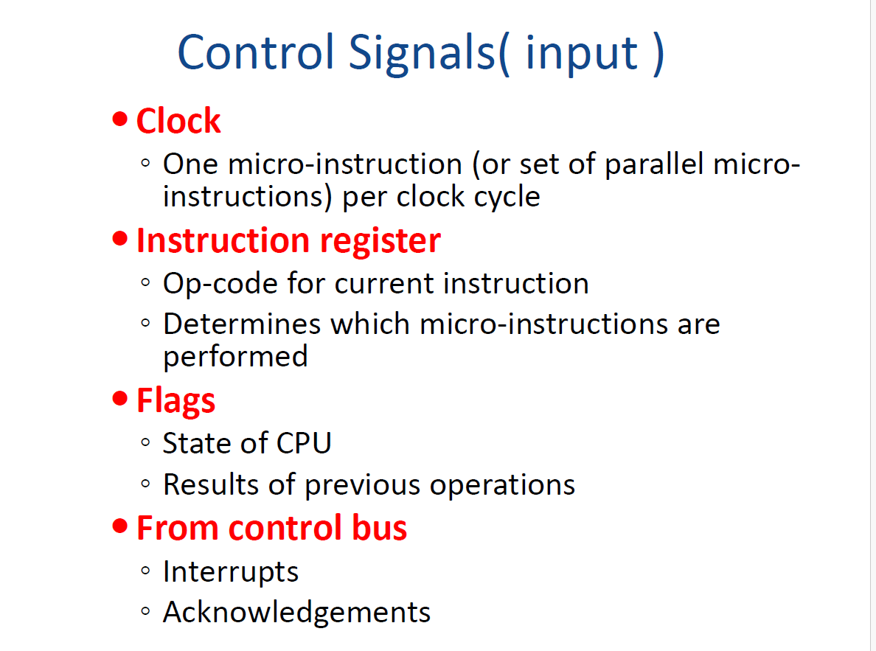

Slide 25
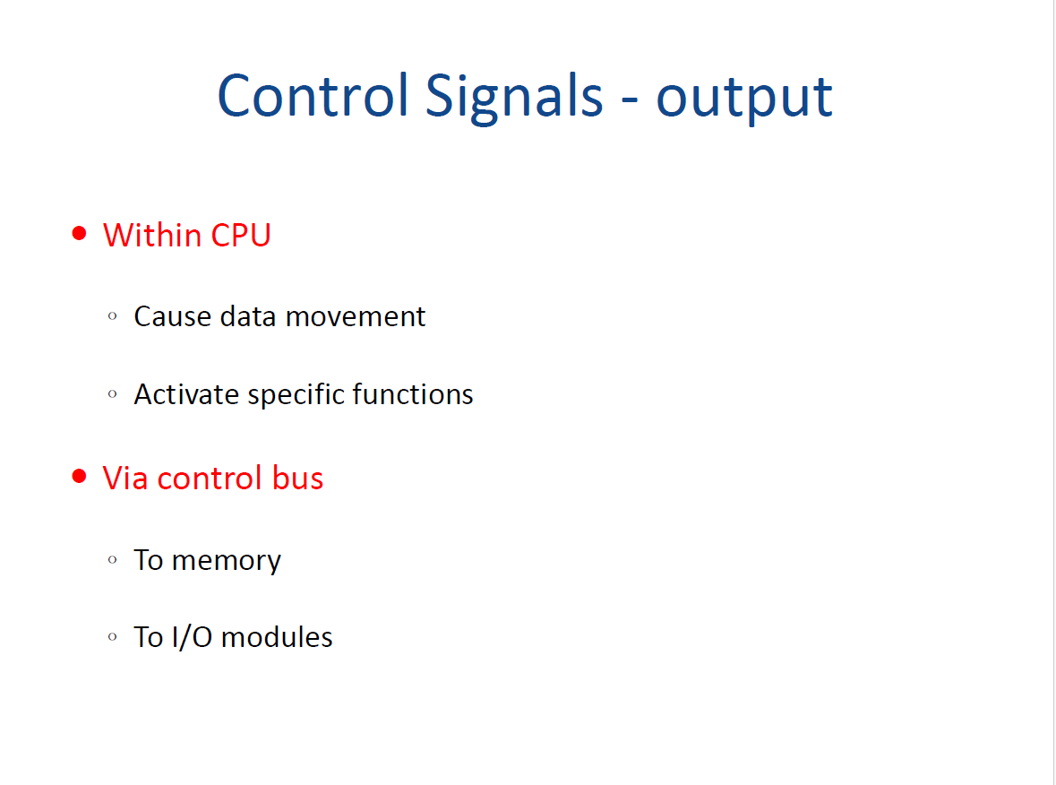

Slide 26
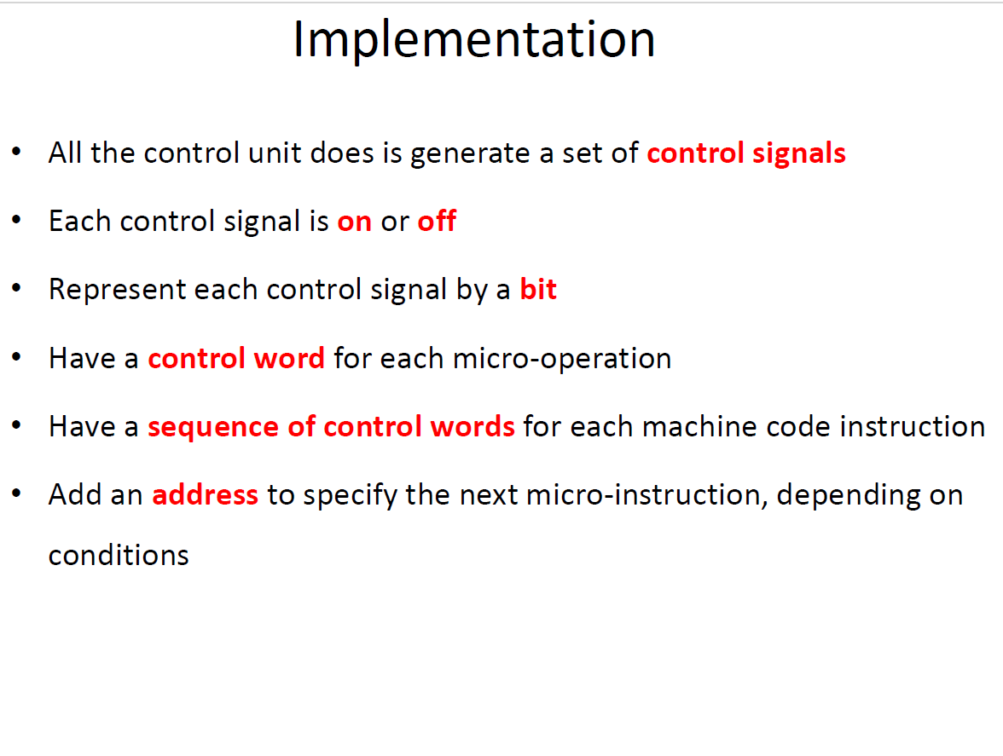

Slide 27
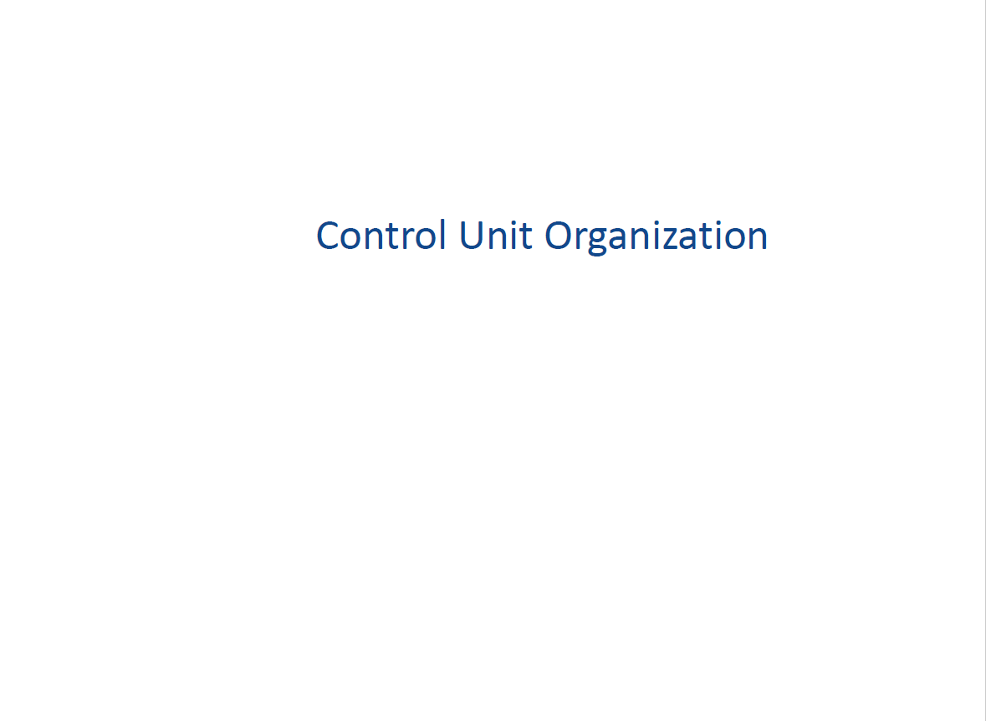

Slide 28
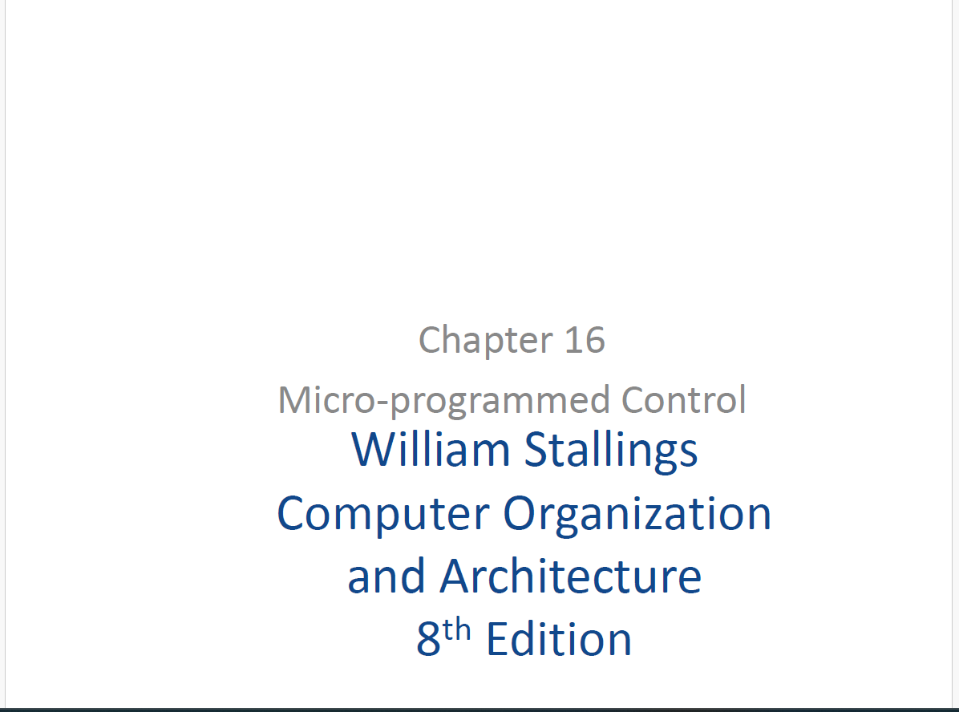

Slide 29
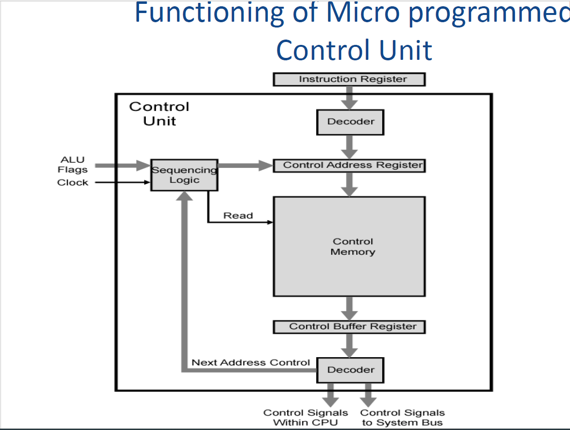

Slide 30
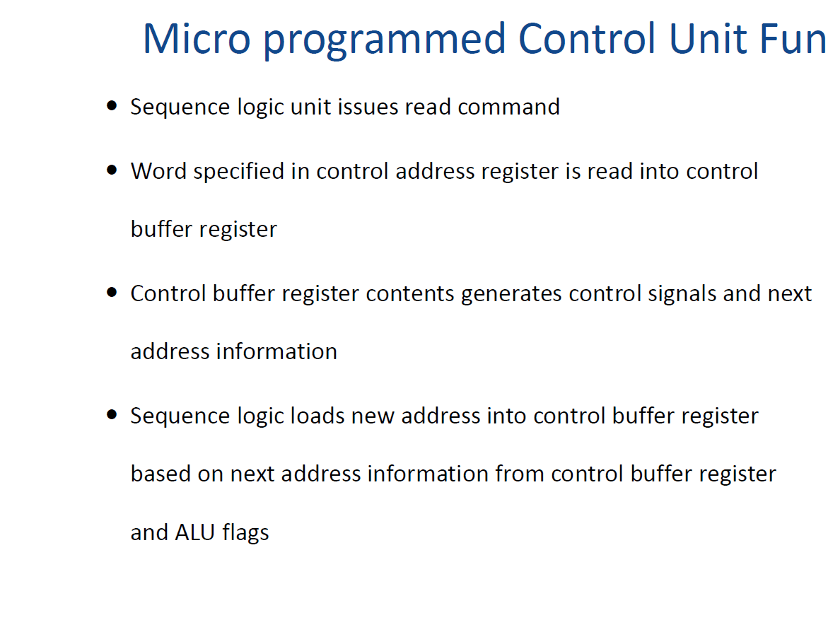

Slide 31
Next Address Decision
The address of the next microinstruction to be executed is in one of these categories:
• Determined by instruction register
• Next sequential address
• Branch
The first category occurs only once per instruction cycle, just after an instruction is fetched.
The second category is the most common in most designs.
Branches, both conditional and unconditional, are a necessary part of a microprogram.
–So branches also decides the next Instruction.

Slide 32
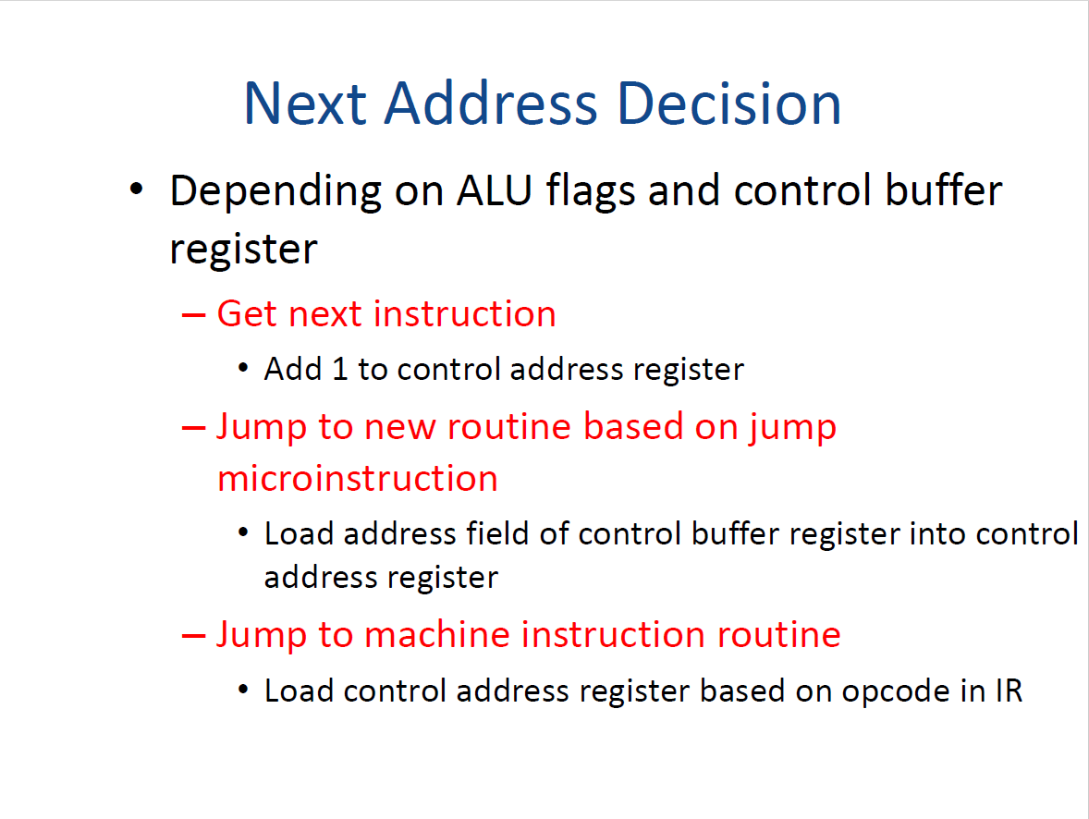

Slide 33
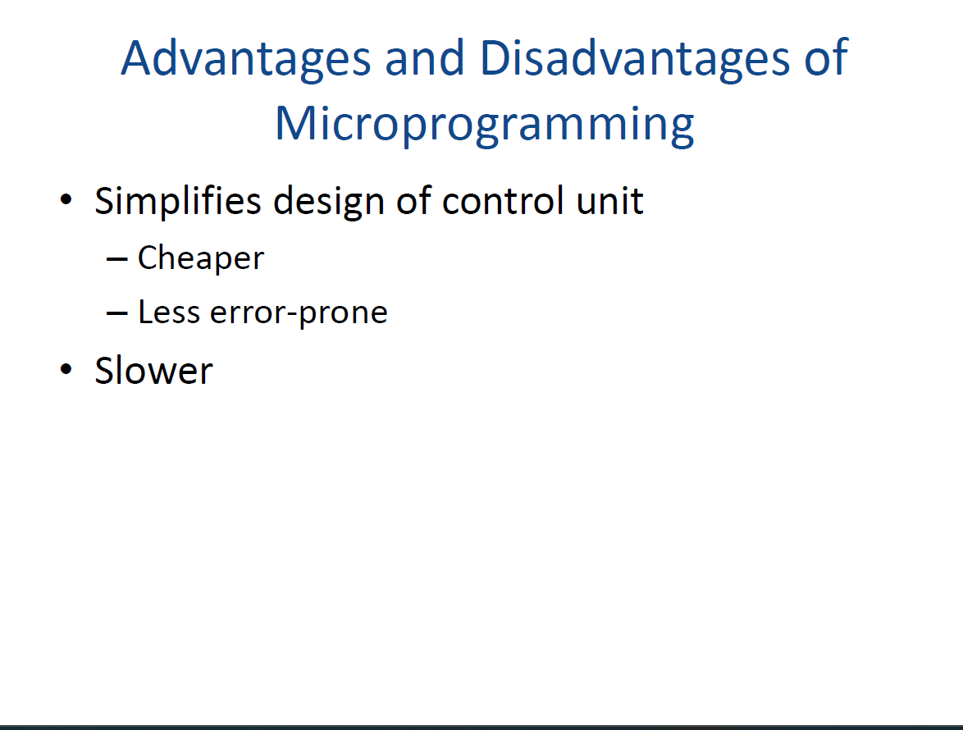

Slide 34
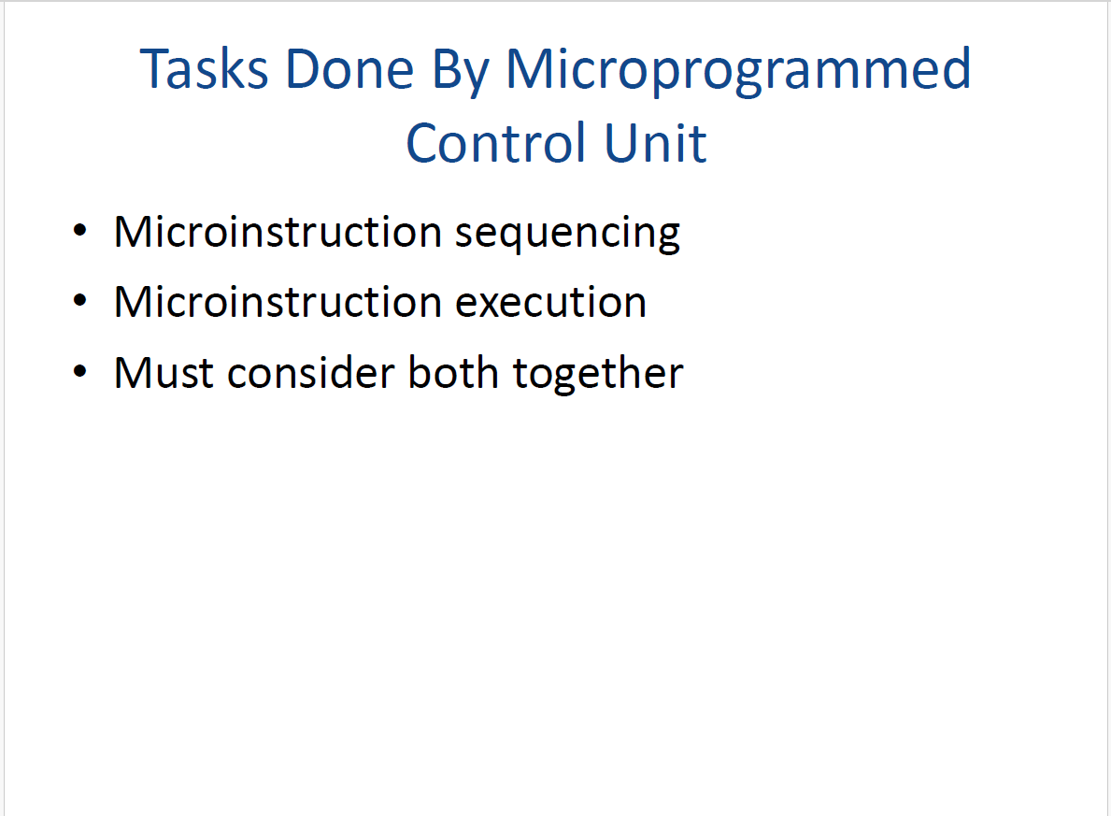

Slide 35
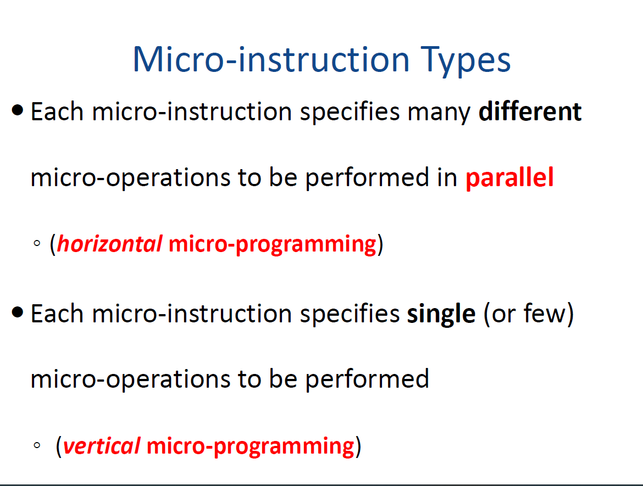

Slide 36
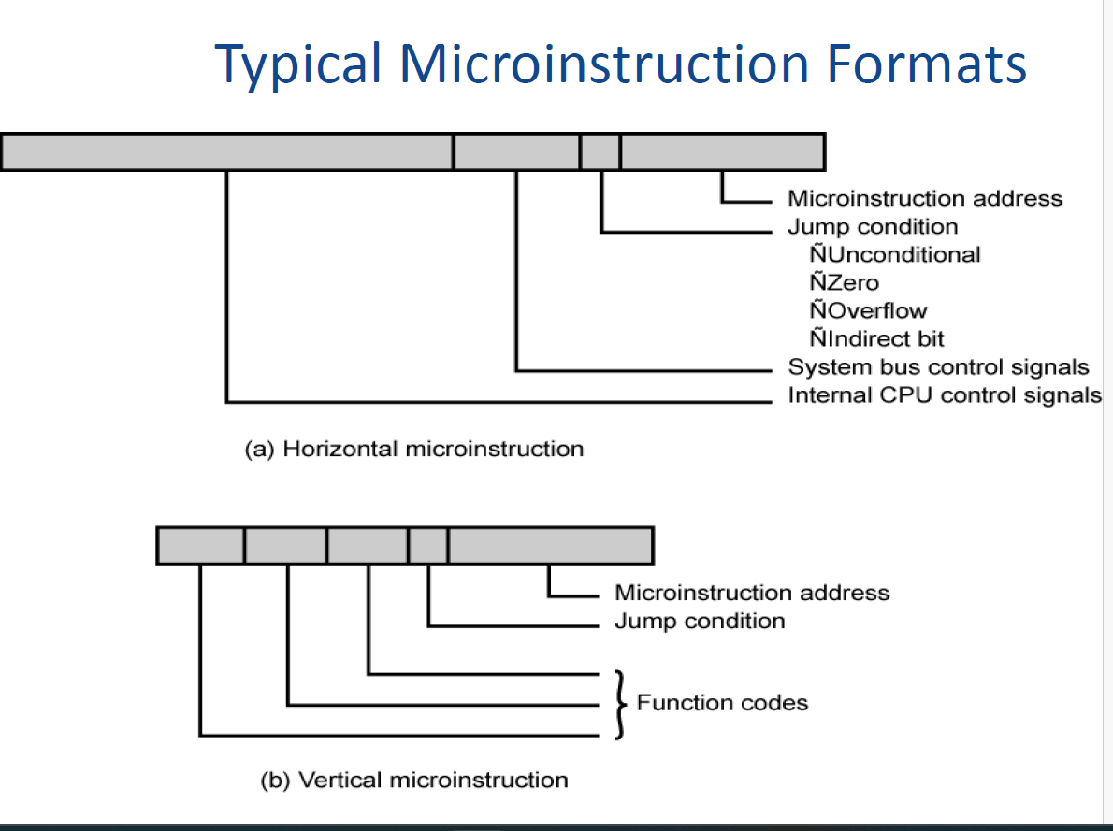

Slide 37
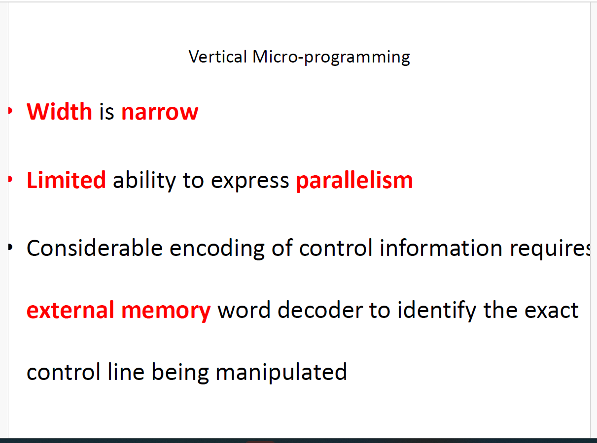

Slide 38
